Slide 1

Author
Title
Additional Information Required

Slide 2

Subtitle
Level 3 heading
Development
Title

Slide 3
Subtitle
Level 3 heading
Development
Title

Slide 4
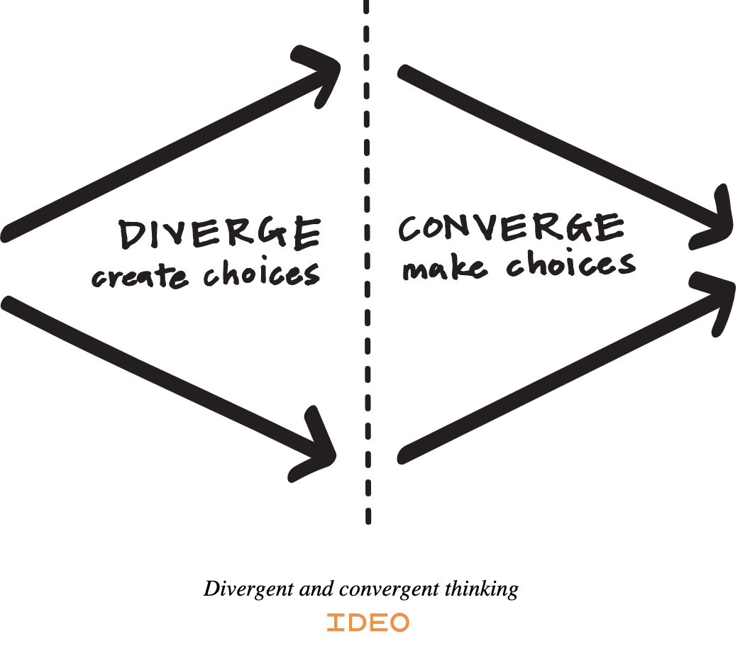
Origins
Example Case
“The team put in the work trying to define design, process, methods, etc. What we did with the Double Diamond was codify it, rename the steps and popularise it. It was important work, but we were certainly standing on the shoulders of giants.”
Richard Eisermann, 2018
Double Diamond, an Icon of a Cliché?

